Slide 1
Sacred Heart Canossian College

Slide 2
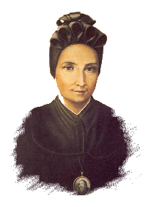
Our Foundress' Mission
Canossian educator should try to handle each one in the way she is made, valuing the benefit of education in the formation of the heart.

Slide 3
Our Motto - "VIA VERITAS VITA"
Our motto draws its inspiration from Jesus Christ who is THE WAY, THE TRUTH and THE LIFE. We take Him as our model and seek to follow His footsteps.
VIA - WAY
To walk confidently and joyfully in the path of life, overcoming all difficulties with fortitude and prayer.
VERITAS - TRUTH
To be sincere in word and action, and to be open to truth and knowledge.
VITA - LIFE
To live for others, be ready to share, serve and sacrifice for others.

Slide 4
School Mission
We aim at providing an all-round education of Christian values and formation of the heart to empower our youngsters to be women of integrity and versatility with global awareness.

